Slide 1
Boxcar and Freight Train
By: Douglas, Archie, Megan, Michael, Jared, Brendan

Slide 2
Boxcar
-For this assignment, we are going to be making a boxcar class which represents a single boxcar on a train. The boxcar holds cargo of a specific type, and an amount of that cargo. It can also either be in operation or in need of repairs.
Template: https://s3.amazonaws.com/term.2/week04/Boxcar.java
Runner File: https://s3.amazonaws.com/term.2/week04/Solution/Student_Runner_Boxcar.java

Slide 3
Parts of the Boxcar - Variables
String cargo - Represents the type of cargo carried by the boxcar. The only possible types are "gizmos", "gadgets", "widgets" and "wadgets."
int numUnits - How many units of cargo the Boxcar is carrying. Can only be between 1 and 10 inclusive.
boolean repair - Boolean that describes whether or not the Boxcar is in need of repairs. If it is true, numUnits is set to zero.
*Variables should be declared as private and accessed through accessor methods

Slide 4
Part of the Boxcar - Constructors
Boxcar() - Default constructor that sets the boxcar to “gizmos”, 5 units, and in service (not in repair).
Boxcar(String c, int u, boolean r) - Sets each of the variables to the parameter if they meet the variable's conditions from the previous slide.

Slide 5
Parts of the Boxcar - Accessor Methods
String getCargo() - Returns the Boxcar’s cargo type. (Returns the variable cargo)
boolean isFull() - Returns whether or not the Boxcar is full of it's cargo. (Check if numUnits is equal to 10.)
String toString() - Returns a String with the following format (example):
-1 space between numUnits and cargo. Tab (“\t”) between cargo and repair.

Slide 6
Parts of the Boxcar - Mutator Methods
void loadCargo() - Increase the current units of cargo by 1. If adding causes it to exceed the maximum of 10, leave the value at 10. Must be set to zero if repair is true.
void setCargo(String c) - Set cargo to c. Only if c is equal to "gizmos", "gadgets", "widgets" or "wadgets." (Ignoring case. Use .equalsIgnoreCase() to check.) The value stored should also be lowercase. (Use .toLowerCase()) If c does not equal any of these, set cargo to “gizmos.”
void callForRepair() - Set the repair boolean to true. Also set numUnits equal to zero.

Slide 7
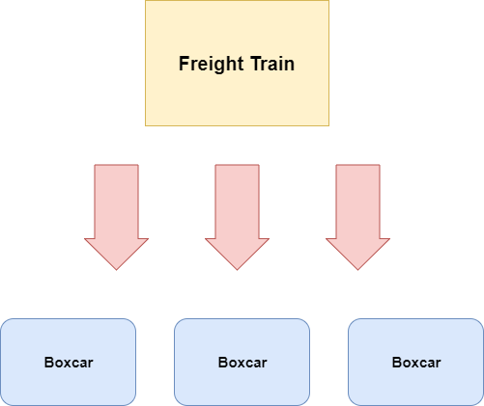
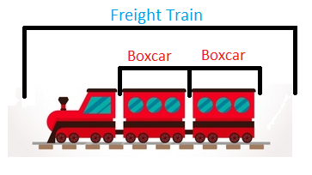
Freight Train
-The Freight Train class acts as a train that contains multiple boxcars.

Slide 8
Freight Train
*Note: This assignment relies on the Boxcar class. Make sure it is finished before starting this one.
Template: https://s3.amazonaws.com/term.2/week04/FreightTrain.java
Runner File: https://s3.amazonaws.com/term.2/week04/Solution/Student_Runner_FreightTrain.java

Slide 9
Parts of the Freight Train - Variables
ArrayList<Boxcar> train - Use an ArrayList to store Boxcars in the Freight Train class.

Slide 10
Parts of the Freight Train - Constructors
FreightTrain() - Sets train to an ArrayList holding one boxcar containing 5 gizmos, that is not in repair.
FreightTrain(int n) - Sets train to an ArrayList of size n, holding n boxcars each containing 5 gizmos and not in repair. (Use a for loop) If n ≤ 0, then the train should be set to size one, with a single boxcar holding 5 gizmos and not in repair.

Slide 11
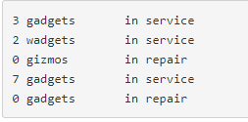
Parts of the Freight Train - Accessor Methods
String toString() - Returns a String representation of the Boxcar objects in the train, in the same format as the Boxcar’s toString method. (For each loop recommended) Example:

Slide 12
Parts of the Freight Train - Mutator Methods
void setCargo(String c) - Set cargo of all of the boxcars in the train to c. Only if c is equal to "gizmos", "gadgets", "widgets" or "wadgets." (Ignoring case. Use .equalsIgnoreCase() to check.) The value stored should also be lowercase. (Use .toLowerCase()) If c does not equal any of these, set cargo to “gizmos.”
void setMultiCargo() - This method Sets the Boxcar’s cargo type to this alternating pattern: "gizmos", "gadgets", "widgets", "wadgets", "gizmos", "gadgets", "widgets", "wadgets", ... until the end of the train.
void fillTrain() - This method Fills all boxcars in the train to the maximum capacity of 10. (use loadCargo() on every Boxcar with a for each loop. Check the value with isFull())
void callForRepair(int i) - Sets repair to true of the Boxcar at location i in the ArrayList.

Slide 13
Quiz
https://goo.gl/oZp9xf

